Slide 1
Registers:
Flag Register
IP Register

Slide 2
Flag Register

Slide 3
Flag Register
In 8086 architecture, flag register is of 16 bits.
In flag register, there are 9 bits and some other bits which are empty.
Those other bits would not be used by us now.
Because It’s a complete register and in future may be some new bit got invented, then these empty spaces would accommodate those new bits.
If we didn’t reserve empty spaces, then in future we have to construct new flag register of more bits which would be very expensive/ costly.

Slide 4
Flag Register
Flag register represents the overall state of the microprocessor.
There are bits in the flag register.
Each bit has its own meaning.
Now, we will see those bits one by one.

Slide 5
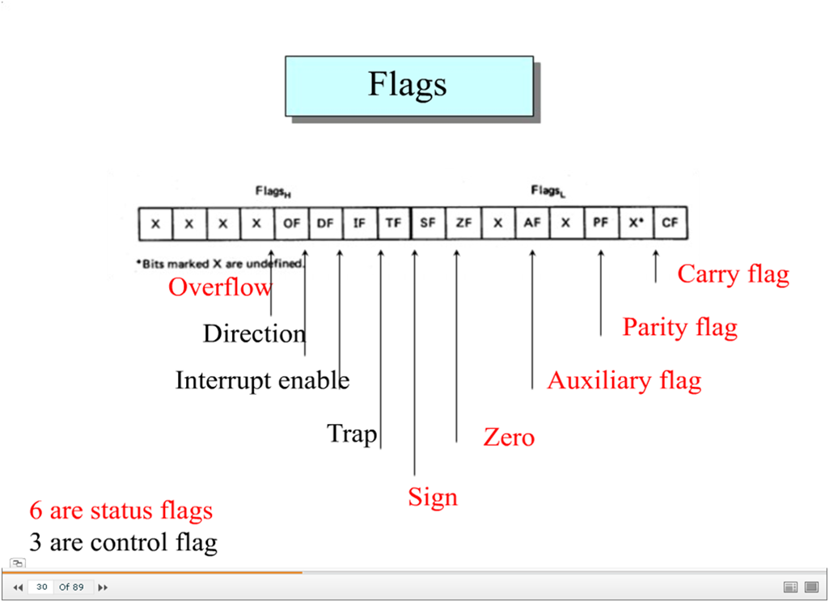

Slide 6
Flag Register
Each bit or each flag of flag register can have one of two values i.e. Either 1 or 0.
Now we’ll see when the value of flag gets 1 or 0.

Slide 7
Flag Register: CF – Carry Flag
When we add two numbers;
If there is carry in the last or at the end of the addition operation, then value of carry flag gets 1. Data would not get wasted since there were only 8 bits to store data. So the last one extra carry bit would set into Carry Flag.
If there is no carry in the last, then value of carry flag gets 0.
1
1
1
1
1
0
0
0
0
1
1
1
1
15
+
1
1
1
1
1
0
0
0
245 (-8)
0
0
0
0
0
1
1
1
7
Carry = 1 Overflow = 0

Slide 8
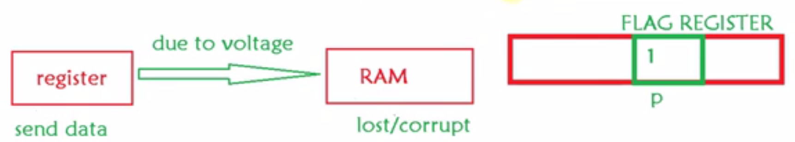
Flag Register: PF – Parity Flag
Parity Flag is used for error detection and correction…
To ensure that
Received data matches the sent data or not.

Slide 9
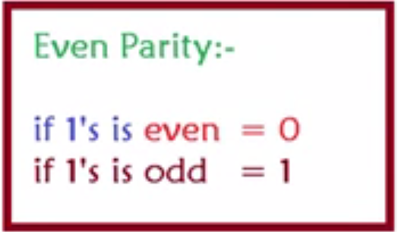
Flag Register: PF – Parity Flag
We can set Parity as:
Even Parity
Odd Parity
In example, we’ll see Even Parity.

Slide 10
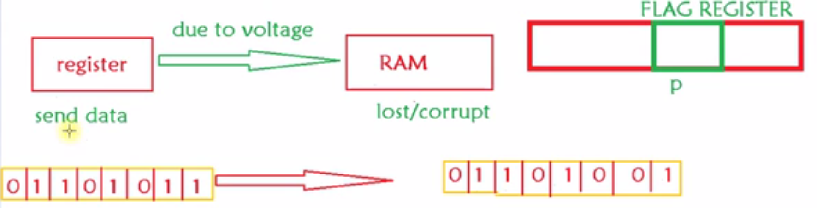
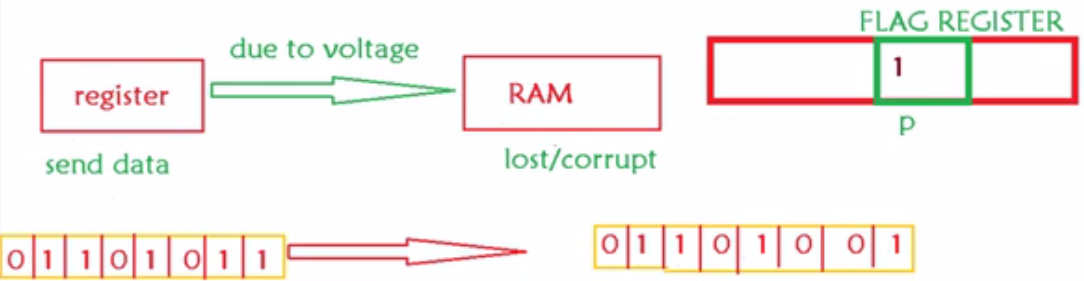
Flag Register: PF – Parity Flag: Example
Odd no. of one’s
Received Data is corrupted

Slide 11
Flag Register: AF – Auxiliary Flag
Auxiliary flag is used very minimal.
It gets one when there is carry after 3rd bit.
Group of 4 bits is known as Nibble.
If there is carry in Nibble, then Auxiliary Flag gets one.

Slide 12
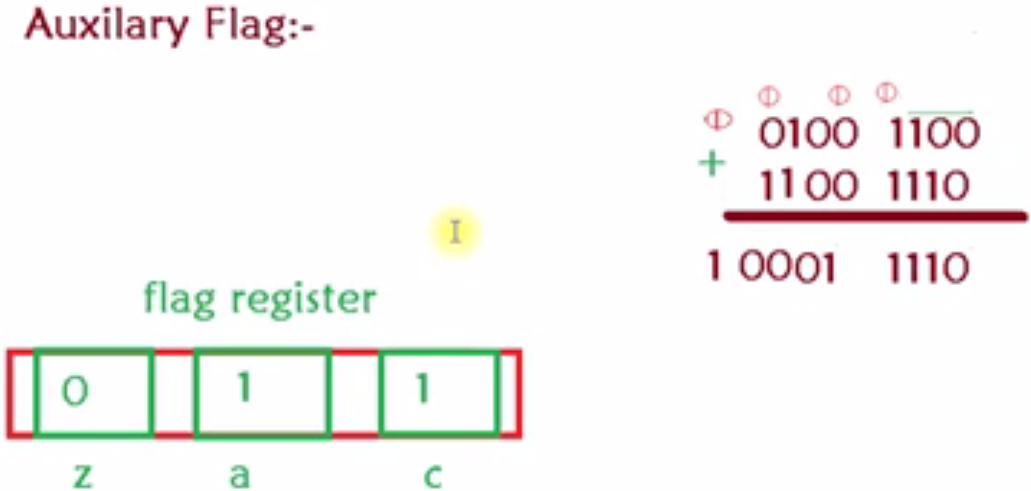
Flag Register: AF – Auxiliary Flag

Slide 13
Flag Register: ZF – Zero Flag
Value of Zero Flag sets to 1 when:
We do any operation and the answer is 0.
e.g. If we do 2-2 then answer would be 0, Zero Flag would set to 1.

Slide 14
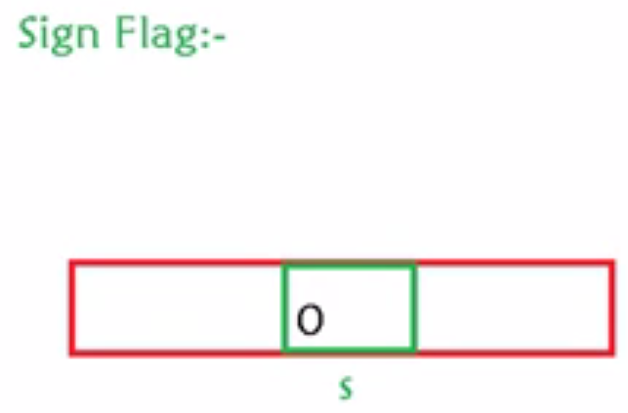
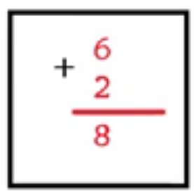
Flag Register: SF – Sign Flag
If we do any operation and the result is positive value then Sign Flag would set to 0.
Value of Sign Flag would set to 1 if the result of any operation is negative value.

Slide 15
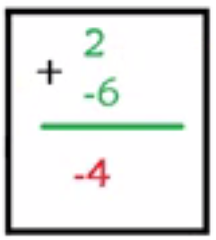
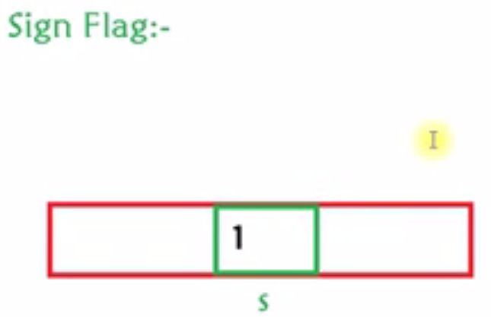
Flag Register: SF – Sign Flag

Slide 16
Flag Register: TF – Trap Flag
Trap Flag is basically used to facilitate Debuggers.
When value of Trap Flag is set to 1, Debugger goes to single step execution mode.
Step by step to see the value of registers and memory.
We’ll see the execution in the next lecture.

Slide 17
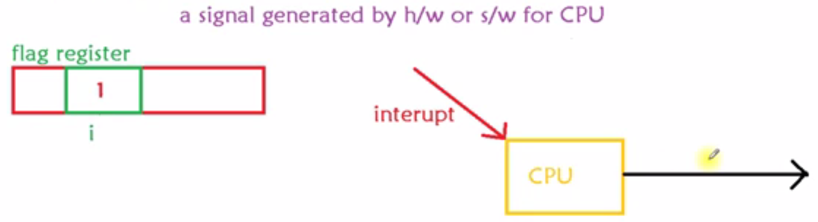
Flag Register: IF – Interrupt Flag
Interrupt is a signal from hardware or software to CPU.
Whenever there is some problem in the hardware or software needs any service, then interrupt is send to CPU.

Slide 18
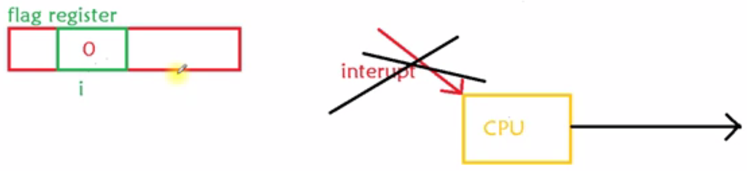
Flag Register: IF – Interrupt Flag

Slide 19
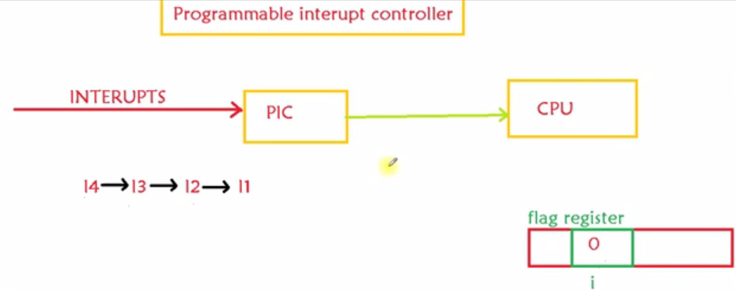
Flag Register: IF – Interrupt Flag

Slide 20
Flag Register: DF – Direction Flag
Direction Flag tells us how to process a String.
Whether Left to right or Right to left.

Slide 21
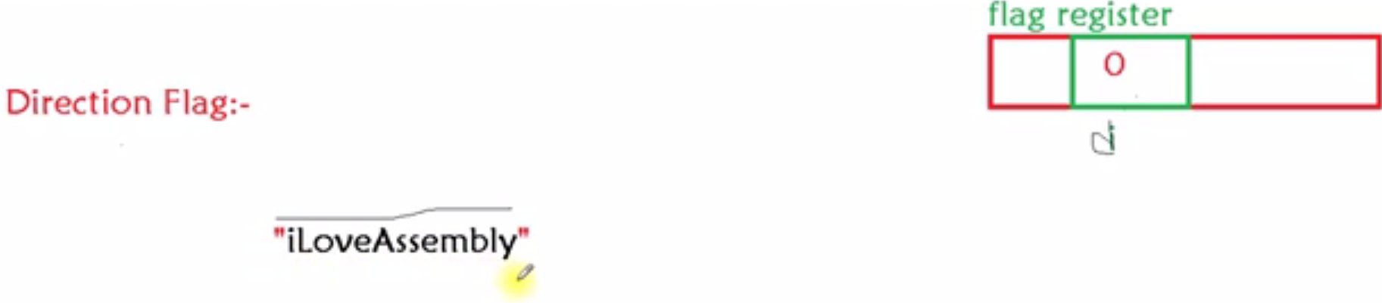
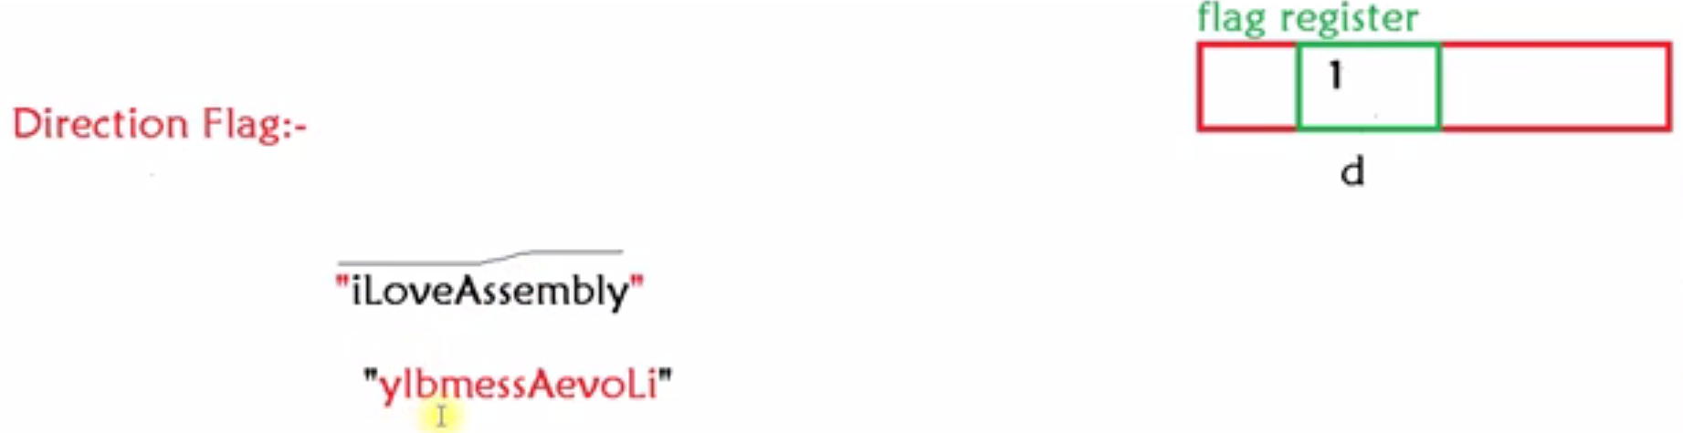
Flag Register: DF – Direction Flag

Slide 22
Flag Register: OF – Overflow Flag
1
0
1
0
0
1
1
1
1
79
+
0
1
0
0
0
0
0
0
64
1
0
0
0
1
1
1
1
143
(-113)
Carry = 0 Overflow = 1

Slide 23
IP Register

Slide 24
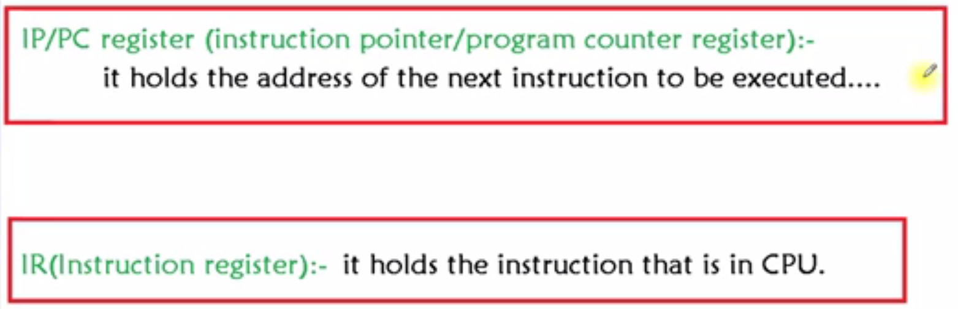
Assembly is very powerful language as
it gives direct access to machine.
Viruses place address of their instructions in the PC.
That’s how Virus enters your system.
Notes:
Assembly is very powerful language as it gives direct access to machine.
Viruses place address of their instructions in the PC. That’s how Virus enters your system.

